Slide 1
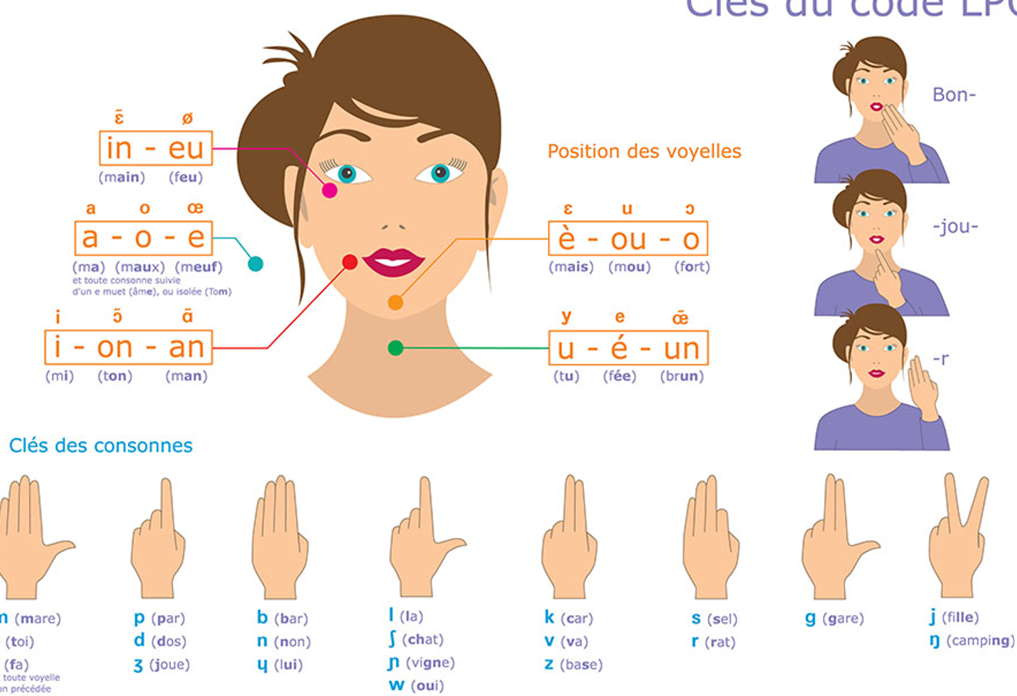
Position 1 - pommette
Position 3 - monton
Position 0 - coté
Position 2 - bouche
Position 4 - gorge

Slide 2




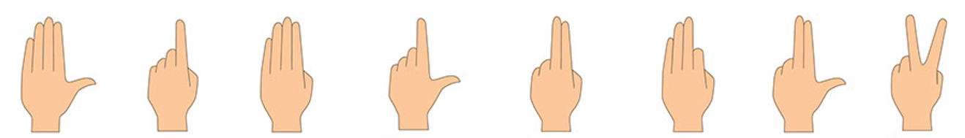


Slide 3
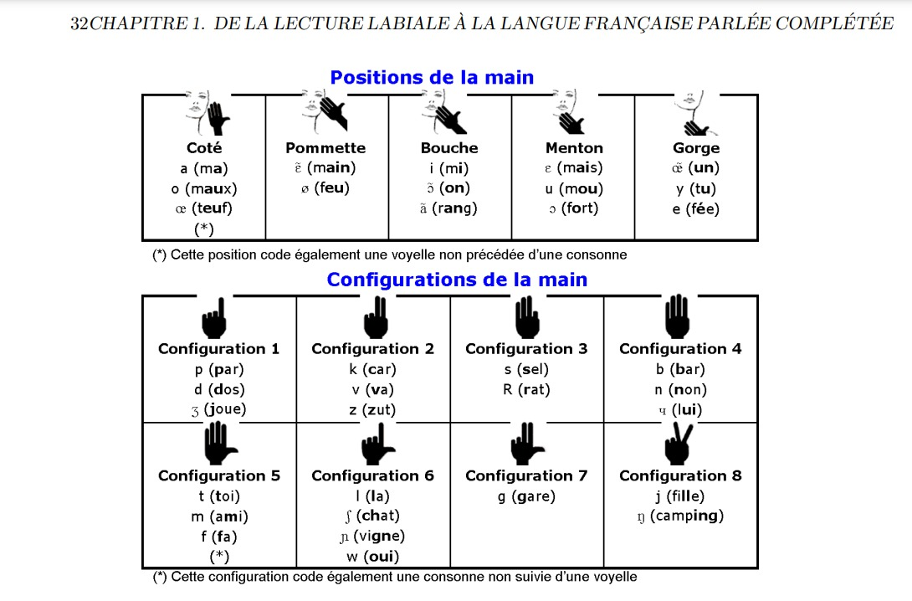
position | position group | vowel |  | confirguration | confirguration group | consonant
coté | 0 | a |  | 1 | 0 | p
coté | 0 | o |  | 1 | 0 | d
coté | 0 | 9 |  | 1 | 0 | Z
pommette | 1 | 5 |  | 2 | 1 | k
pommette | 1 | 2 |  | 2 | 1 | v
bouche | 2 | i |  | 2 | 1 | z
bouche | 2 | § |  | 3 | 2 | s
bouche | 2 | @ |  | 3 | 2 | R
monton | 3 | E |  | 4 | 3 | b
monton | 3 | u |  | 4 | 3 | n
monton | 3 | O |  | 4 | 3 | 8
gorge | 4 | 1 |  | 5 | 4 | t
gorge | 4 | y |  | 5 | 4 | m
gorge | 4 | e |  | 5 | 4 | f
 |  |  |  | 6 | 5 | l
 |  |  |  | 6 | 5 | S
 |  |  |  | 6 | 5 | N
 |  |  |  | 6 | 5 | w
 |  |  |  | 7 | 6 | g
 |  |  |  | 8 | 7 | j
 |  |  |  | 8 | 7 | G

Slide 4








Position 0 - coté
shape 0
shape 1
shape 2
shape 3
shape 4
shape 5
shape 6
shape 7

Slide 5
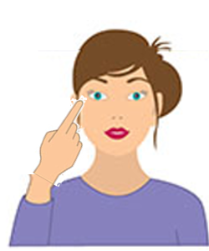
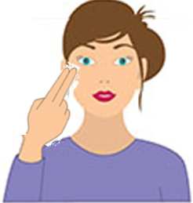



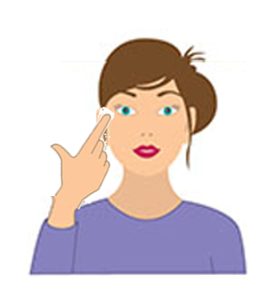


Position 1 - pommette
shape 0
shape 1
shape 2
shape 3
shape 4
shape 5
shape 6
shape 7

Slide 6
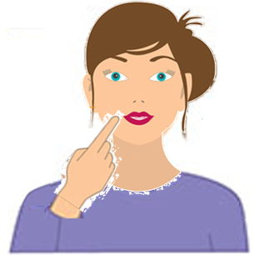
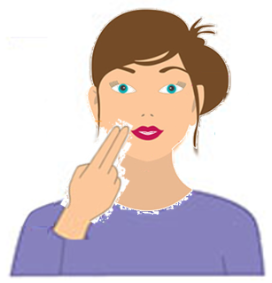
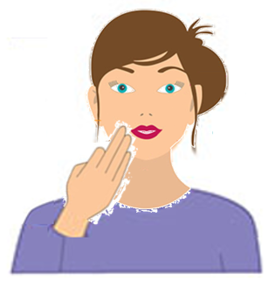
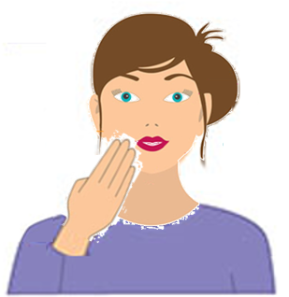
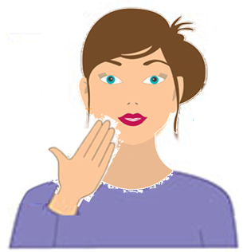
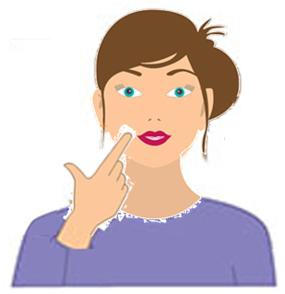
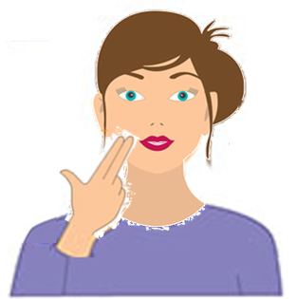
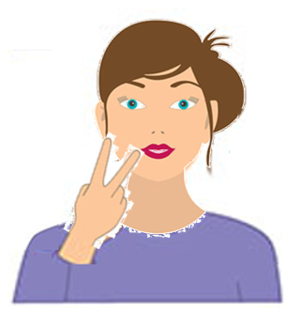
Position 2 - bouche
shape 0
shape 1
shape 2
shape 3
shape 4
shape 5
shape 6
shape 7

Slide 7
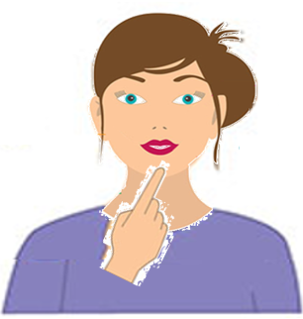
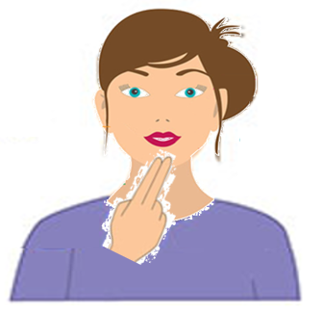
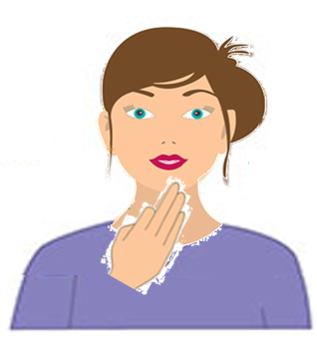
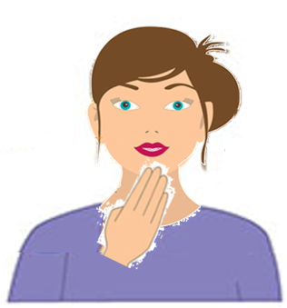
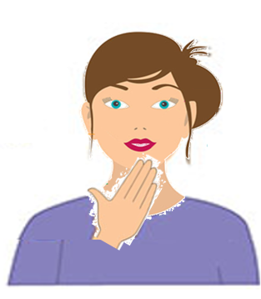
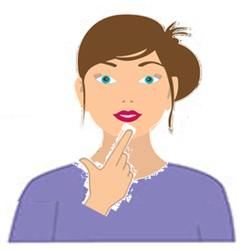
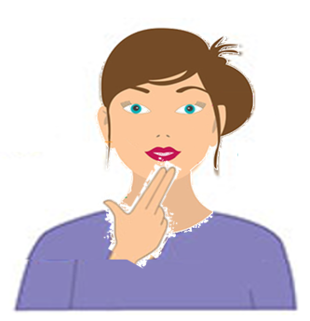
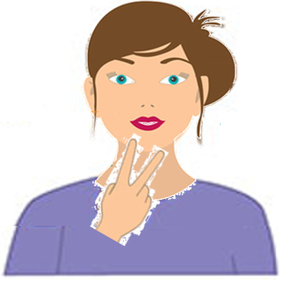
Position 3 - monton
shape 0
shape 1
shape 2
shape 3
shape 4
shape 5
shape 6
shape 7

Slide 8
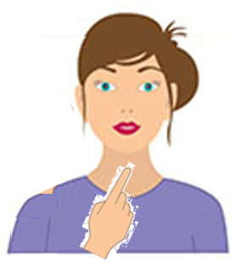
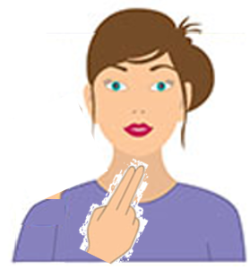


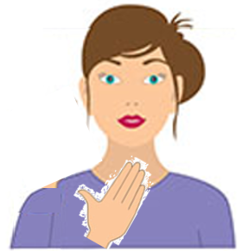
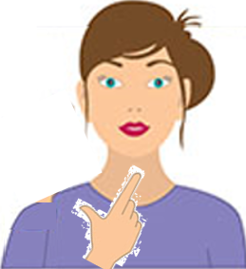
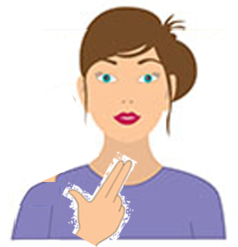
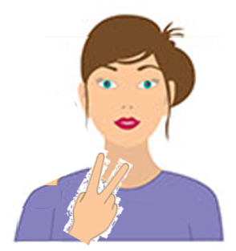
Position 4 - gorge
shape 0
shape 1
shape 2
shape 3
shape 4
shape 5
shape 6
shape 7

